Slide 1
Module 6: Using Notification Services

Slide 2

Overview
Notification Services Architecture
Building Notification Services Solutions

Slide 3
Lesson: Notification Services Architecture
Notification Services Architecture
How Subscription Management Works
How Event Collection Works
How Notification Generation Works
How Notification Formatting and Delivery Work
An Adventure Works Notification Services Application

Slide 4
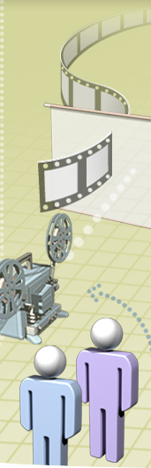
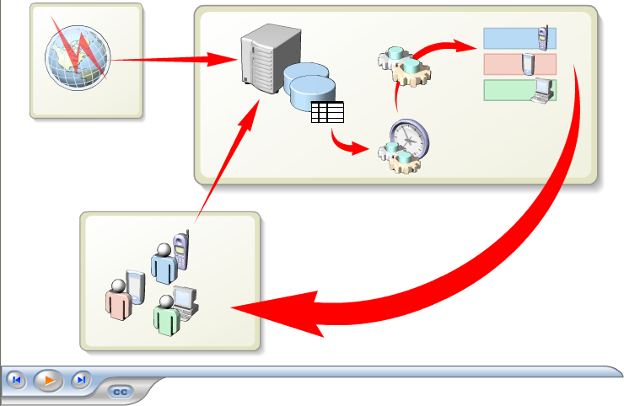
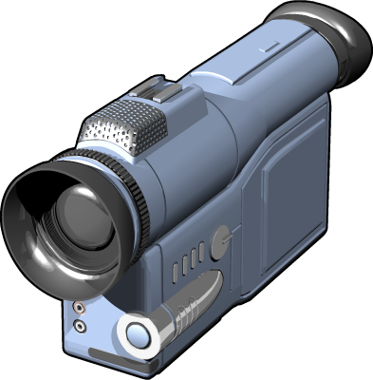
Multimedia: SQL Server 2005 Notification Services

Slide 5

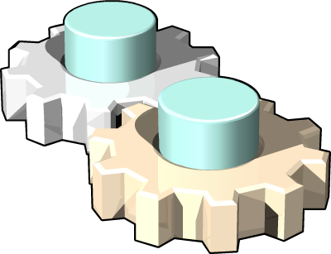


Notification Services Architecture
Logical architecture
Physical architecture: Instances
Physical architecture: Applications
An instance contains one or more applications
The instance service and database are defined in a configuration file
The application database is defined in Application Definition File (ADF)
Each solution requires a Notification Services instance
An instance contains one or more applications
An instance is defined in a configuration file
An instance is implemented as a Windows service with a database
Each application is defined in an Application Definition File (ADF)
Each application has its own database
Instance
Config
Windows service
Instance database
Application
Application
ADF
ADF
Application database
Application database

Slide 6

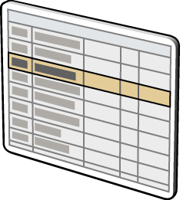
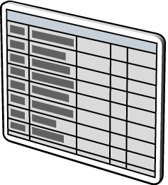
How Subscription Management Works
Subscription Management Objects
  Managed or COM API
Subscribers
Subscriber
Subscription Management Objects
SubscriberDevice
Subscription
Instance database
Application Database

Slide 7


How Event Collection Works
Standard or custom event providers
Hosted or independent event providers
COM
.NET
XML
Events
Events
SQL
SP
Application Database

Slide 8

How Notification Generation Works
Generator executes rules (defined in ADF)
Resulting notifications written to notifications table
1
2
Generator
1
SELECT…
Rules
2
Notifications
Application Database

Slide 9
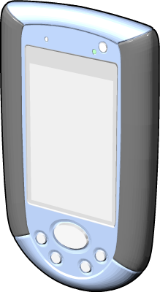

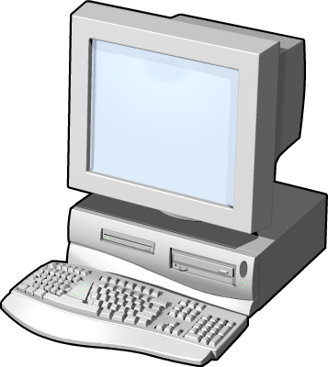
How Notification Formatting and Delivery Work
Distributor applies appropriate formatter
Distributor sends notification to delivery channel
1
2
Content Formatter
1
SMTP
Distributor
2
HTTP
Notifications
FILE
Application Database
Delivery Channel

Slide 10

An Adventure Works Notification Services Application
Customer adds subscription
1
1
6
Event occurs
2
New
product
Notifications are generated
3
2
3
Notifications are formatted
4
4
Notifications are submitted to delivery channel
5
Notifications are delivered
SMTP
6
5

Slide 11
Lesson: Building Notification Services Solutions
The Notification Services Application Development Process
Considerations for Designing a Notification Services Solution
The Configuration File
The Application Definition File
How to Manage Notification Services with SQL Server Management Studio
How to Use the NSControl Utility
Subscription Management Applications
How to Use Event Providers
Best Practices for Notification Services

Slide 12
The Notification Services Application Development Process
Development process
Design the solution
1
Create the configuration and ADF files
2
Register and build with NSControl.exe
3
Create a subscription management application
4
Implement an event provider
5

Slide 13
Considerations for Designing a Notification Services Solution
Design considerations:
Instance and application configuration
Data structure design
Notification rules
Chronicle tables
Notification formatting
Notification delivery
Physical deployment

Slide 14
The Configuration File
Parameters
File documentation
Instance settings
Application settings
Protocol settings
Delivery channels
Argument encryption

Slide 15
The Application Definition File
Parameters
File documentation
Database settings
Event classes
Subscription classes
Notification classes
Provider settings
Generator settings
Distributor settings
Application execution settings

Slide 16
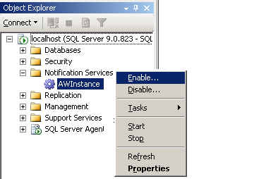
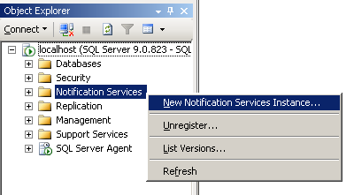
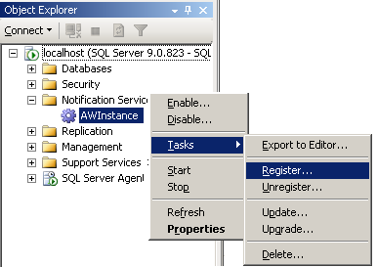
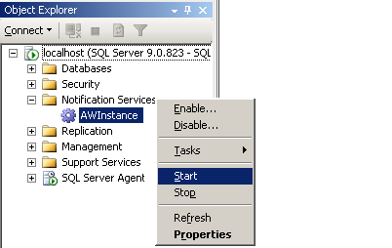
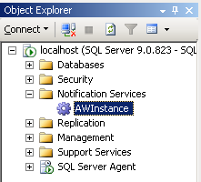
How to Manage Notification Services with SQL Server Management Studio
Create the instance and applications
Register the instance
Enable the instance
Start the instance
1
2
3
4

Slide 17
How to Use the NSControl Utility
Create the instance and applications
Register the instance
Enable instance components
1
2
3
nscontrol create –in "config.xml"
nscontrol register –name AWInstance -service
-serviceusername "SQLUser"
-servicepassword "P@ssw0rd"
nscontrol enable –name AWInstance

Slide 18

Demonstration: Using NSControl
In this demonstration, you will see how to:
Create an instance and application
Register an instance
Enable an instance

Slide 19
Subscription Management Applications
NSInstance class
NSApplication class
Subscriber class
SubscriberDevice class
Subscription class
Dim inst As New NSInstance("AWInstance")
Dim app As New NSApplication(inst, "ProductApp")
Dim Subr As New Subscriber(inst)
Dim SubDev As New SubscriberDevice(inst)
Dim Subn As New Subscription(app, "NewProductSub")

Slide 20
Demonstration: A Subscription Management Application
In this demonstration, you will see how to:
Add a subscriber
Add a subscriber device
Add a subscription

Slide 21
How to Use Event Providers
Event providers:
Standard providers
  FileSystemWatcher
  SQL Server
Custom provider APIs
  Managed event API
  COM event API
  XML event API
  SQL Server event API

Slide 22
Demonstration: An Event Provider
In this demonstration, you will see how to use the managed API event provider

Slide 23
Best Practices for Notification Services
Process events in batches
Use digest or multicast notifications
Don’t use subscriber-specific events
Add indexes to chronicle tables
Clear stale data

Slide 24

Lab 6: Using Notification Services
Exercise 1: Creating a Notification Services Application
Exercise 2: Creating a Subscription Management Application
Exercise 3: Creating an Event Provider

